Slide 1
What’s cool about functional programming
You don’t solve different problems in FP. But you solve them differently.
Thomas Mahler | Senior IT Architect | November 2020
Notes:
This talk is about functional programming, and why it’s an important topic for software developers.
At ista we mainly use imperative or object-oriented languages like ABAB, Java, C#,...
(And yes we also use some hybrid or multi-paradigm languages like Scala, Kotlin, JavaScript, TypeScript)
Those languages provide us with certain tools and patterns to structure our programs, work with data, handle state, have persistence, handle exceptions…
So they shape the way how we look at things when solving problems.
Today I want to look at the same problems, but from a different angle. From the FP perspective.
As it’s stated in the subtitle: You don’t solve different problems in FP. But you solve them differently.
This talk will give you a brief overview of basic elements of functional programming.
We want to get an idea how things are solved differently in FP. And how FP concepts might be helpful in our day to day work.

Slide 2
Agenda
1.
Introduction to basic concepts, features and techniques of functional programming
2.
Benefits of FP for software developers
3.
Questions / Discussion
Notes:
Ok, here comes the agenda for my presentation,
In the main part of this session I‘ll introduce basic ideas, concepts and techniques of FP.
In the second part we‘ll briefly discuss how the things that we have seen so far can be beneficial for software development.
Finally, There‘ll be room for discussion and questions.
So now, without further ado, let‘s start.

Slide 3
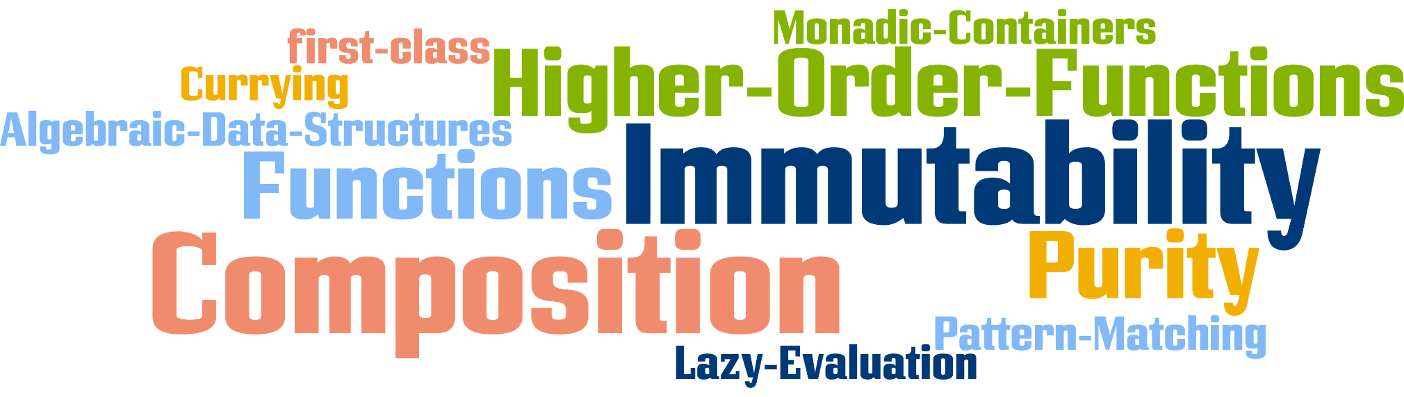

Learning a new paradigm: So many new concepts, ideas, Terms …
“In computer science, functional programming is a programming paradigm where programs are constructed by applying and composing functions. It is a declarative programming paradigm in which function definitions are trees of expressions that each return a value, rather than a sequence of imperative statements which change the state of the program.”
What does it mean?
How does it matter to developers?
Notes:
So we come from imperative or OO languages and want to learn about a new paradigm.
This will a bit of work and may even a bit painful.
If we go to the Internet to learn about FP we‘ll get flooded with a lot of buzzwords. For example take the following definition from Wikipedia:
“functional programming is a programming paradigm where programs are constructed by applying and composing functions. It is a declarative programming paradigm in which function definitions are trees of expressions that each return a value, rather than a sequence of imperative statements which change the state of the program.”
Does that explain anything?
Well, maybe for some.
For the rest of us we’ll have to take a much closer look at those new terms and ideas, to really under stand what they mean.
And how they matter for us.
So we’ll take the time to look at at this stuff one by one…

Slide 4
Functions are first class citizens
Wikipedia: “In functional programming (FP), functions are treated as first-class citizens, meaning that
they can be bound to names (including local identifiers), (1)
passed as arguments, (2)
and returned from other functions, just as any other data type can. (3)
This allows programs to be written in a declarative and composable style, where small functions are combined in a modular manner.”
As this is at the core of FP, we’ll have a closer look at each of these 3 properties.
All code-examples are in the Haskell language.
Notes:
So here comes the first core idea: …
I‘ve chosen Haskell because it is one of the languages that stick most purely to the FP concepts. This will allow to present the FP ideas in a much clearer way than in hybrid languages like Scala, Kotlin or Rust.

Slide 5
Functions can be bound to names (1)
-- define constant `aNumber` with a value of 42. -- | This is a comment aNumber :: Integer -- | This is a type signature aNumber = 42 -- | This is a definition
-- define constant `aString` with a value of “Hello World“ aString :: String aString = "Hello World"
-- define a function `square` which takes an Integer as argument and compute its square (square 15 -> 225) square :: Integer -> Integer square n = n ^ 2
-- define a function `double` which takes an Integer as argument and compute its double (double 15 -> 30) double :: Integer -> Integer double n = 2 * n
Notes:
OK, functions are first class citizens, part 1:

Slide 6
Passing functions as arguments (2)
ifOddDouble :: Integer -> Integer ifOddDouble n = if odd n then double n else n
ifOddSquare :: Integer -> Integer ifOddSquare n = if odd n then square n else n
ifOdd :: (Integer -> Integer) -> Integer -> Integer ifOdd growthFunction n = if odd n then growthFunction n else n
ifOddDouble :: Integer -> Integer ifOddDouble n = ifOdd double n
ifOddSquare :: Integer -> Integer ifOddSquare n = ifOdd square n
square :: Integer -> Integer square n = n ^ 2
double :: Integer -> Integer double n = 2 * n
-- predicate functions on integers
even :: Integer -> Bool
even n = n `rem` 2 == 0
odd :: Integer -> Bool
odd n = n `rem` 2 /= 0
ifOdd is called a higher order function, as it accepts another function as argument.
Great, but now the customer wants functions that only act on even numbers.
A function ifEven :: (Integer -> Integer) -> Integer -> Integer would have to repeat most of the existing code.
We don‘t want to repeat ourselves, so we must also be able to pass in the predicate function…
Notes:
First class citizens part 2.
Let‘s play a bit with the square and double functions we just defined.
We also use some simple predicate function odd and even that check wether an Integer is odd or even.
So what can we build from this few elements.
We could build a function that doubles all odd numbers:
Or one that squares all odd numbers:
By looking at the code we see that both functions have exactly the same structure, they just vary in the actual growth-function.
So let‘s try to factor the growth function to make our code more generic:
With this ifOdd function we can rewrite the initial functions as follows:

Slide 7

OK, TIMe for some refactoring !
ifPredGrow :: (Integer -> Bool) -- a predicate function argument (e.g. even or odd) -> (Integer -> Integer) -- a growth function argument (e.g. double or square) -> Integer -- the input number -> Integer -- the output number
ifPredGrow predicate growthFunction n = if predicate n then growthFunction n else n
ifEvenDouble :: Integer -> Integer ifEvenDouble n = ifPredGrow even double n
ifEvenSquare :: Integer -> Integer ifEvenSquare n = ifPredGrow even square n
ifOddDouble :: Integer -> Integer ifOddDouble n = ifPredGrow odd double n
ifSmallSquare :: Integer -> Integer ifSmallSquare n = ifPredGrow (\x -> x < 10) square n
(\x -> x < 10) is an anonymous function, also known as a lambda-term (\ resembling the greek letter λ). They can be used in the same way as named functions.
Higher order functions like ifPredGrow form a template which can be used to implement concrete algorithms by filling in the blanks (i.e. The function arguments) [Compare to OO patterns Strategy and Template Method]
Helps to keep us DRY
reduces complexity.
All elements can be tested in isolation, which improves testability

Slide 8
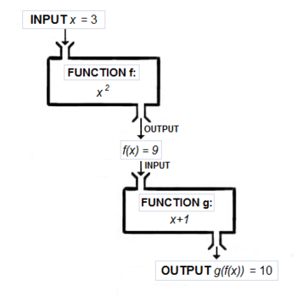
Returning functions as values (3) A. function composition
Function composition is an operation that takes two functions f and g and produces a function h such that h(x) = g(f(x)).
The resulting composite function is denoted h = g ∘ f where (g ∘ f )(x) = g(f(x)).
Intuitively, composing functions is a chaining process in which the output of function f is used as input of function g.
So looking from a programmers perspective the ∘ operator is a function that takes two functions as arguments and returns a new composite function. In an FP language it can be defined as:
(∘) :: (b -> c) -> (a -> b) -> a -> c (g ∘ f) x = g (f x) -- g :: (b -> c), f :: (a -> b), x :: a
-- (add1AfterSquare 3 -> 10) add1AfterSquare :: Integer -> Integer add1AfterSquare x = (add1 ∘ square) x
g ∘ f
Composition allows to build up complex functions from sequences of simpler functions.
This reduces (mental) complexity.
All elementary functions can be unit tested in isolation, which improves testability.
Improves maintainability of the code
square :: Integer -> Integer square n = n ^ 2
add1 :: Integer -> Integer add1 x = x + 1
Notes:
Coming back to our functions as first class citizens topic.

Slide 9
Returning functions as values (3) B. Partial application
-- function adding two numbers (add 2 3 -> 5)
add :: Integer -> Integer -> Integer -- Why not add :: (Integer, Integer) -> Integer ?
add a b = a + b
The type signature can be read as: "A function taking an Integer argument and returning a function of type Integer -> Integer". Sounds weird? But that's exactly what most functional languages do internally. So if we call add 2 3, first add is applied to 2 which returns a new function of type Integer -> Integer which is then applied to 3.
This technique is called Currying. Currying is widely used in FP as it allows another cool technique: partial application:
-- partial application: applying add to 5 returns a function of type Integer -> Integer (add5 7 -> 12) add5 :: Integer -> Integer add5 = add 5
In FP partial application is frequently used to provide functions with configuration data or infrastructure access (e.g. db connections).
It’s the FP equivalent to dependency injection or memoization.

Slide 10
Recursion and pattern matching
Remember the factorial function from high school?
For all n ∈ ℕ₀, n! is defined as:
0! = 1
n! = n * (n-1)!
With our current knowledge we could implement it as:
fac :: Natural -> Natural -- Natural represents ℕ₀
fac n =
if n == 0
then 1
else n * fac (n - 1)
Most pure functional languages provide pattern matching, which allows to declare the function much closer to the original mathematical definition:
fac :: Natural -> Natural
fac 0 = 1
fac n = n * fac (n - 1)
This is cool.
It is easier to read, as it helps to avoid nested if ... then ... else ... constructs that evaluate input parameters.
Pattern matching not only works on numbers but on any other datatypes as well, we’ll see some of this in a few moments…
Notes:
OK, so now that we have learned a bit about functions as first class values we want to explore how we can use them to write programs.
We start with a simple example.

Slide 11
Immutability, purity & equational reasoning
FP languages provide immutability. No value can ever be changed.
There are thus no assigments operations. But what about the = sign?
The = sign is not an assigment, but rather a definition as in mathematics, which declares to things to be identical..
The defining clauses of the fac function can thus be understood as algebraic equations:
fac :: Natural -> Natural
fac 0 = 1 -- (a)
fac n = n * fac (n - 1) -- (b)
Using these equations we can use equational reasoning (term rewrite rules) to understand how a functional program like fac 2 is evaluated:
fac 2 =
= 2 * fac (2 - 1) -- (b)
= 2 * fac 1 -- 2 - 1
= 2 * 1 * fac (1 - 1) -- (b)
= 2 * fac 0 -- 1-1=0 , 2*1=2
= 2 * 1 -- (a)
= 2 -- 2*1=2
Purity: A function is called pure if it corresponds to a function in the mathematical sense: it associates each possible input value with an output value, and does nothing else. In particular,
it has no side effects, that is to say, invoking it produces no observable effect other than the result it returns; it cannot also e.g. write to disk, or print to a screen.
it does not depend on anything other than its parameters, so when invoked in a different context or at a different time with the same arguments, it will produce the same result.
A function like fac is pure, as it solely depends on input values not on anything external.
We can use the same notation that the code uses to reason about the program semantics !
So you‘ll find these kind of reasoning often in FP. What you can proof you don‘t have to test!
Purity also improves testability: It is much easier to set up tests without worrying about mocks or stubs to factor out access to backend layers. This is why in FP you try to write as much pure code as possible and strictly separate it from code that has to interface to the outside world.
Notes:
We have seen how pattern matching allows to write code quite close to the original mathematical equations (modulo some syntax restrictions).
Next we‘ll see that this approach is also very helpful when reasoning about programs.
…
When we reached the result fac 2 = 2:
But what would happen to our nice equations if suddenly an exception is raised because we can‘t read from disk?

Slide 12
Lists
Working with lists is fundamental to most FP languages.
A list can either be the empty list (denoted by the data constructor []) or some first element of a data type a followed by a list with elements of type a, denoted by [a].
This intuition is reflected in the following data type definition:
data [a] = [] | a : [a]
The cons operator (:) (which is an infix operator like ∘) is declared as a data constructor to construct a list from a single element of type a and a list of type [a].
A list containing the three numbers 1, 2, 3 is constructed like this:
myList = 1 : 2 : 3 : [] luckily most FP languages provide some syntactic sugar for lists so you can write it also as:
myList = [1,2,3]
Notes:
OK, we learned how to work with Numbers, now lets work with complexer data types.
For example : Lists !

Slide 13
Pattern matching on lists
When working with lists we will typically use the two branches of the list data type definition for pattern matching:
data [a] = [] | a : [a]
For example take the length function that determines the length of a list:
length :: [a] -> Integer
length [] = 0
length (x:xs) = 1 + length xs
We can read these equations as: The length of the empty list is 0, and the length of a list, whose first element is x and with remainder xs, is 1 plus the length of xs.
Algebraic data types: Most functional languages allows you to create arbitrary data types by combining sum types and product types.
-- two simple sum types:
data Status = Green | Yellow | Red
data Severity = Low | Middle | High
-- a simple product type
data Tuple = Tuple Status Severity
The complete range of data types that can be constructed in this way is called algebraic data types or ADT in short.
Using algebraic data types has several advantages:
Pattern matching can be used to analyze any concrete instance to select different behaviour based on input data.
Compilers can detect incomplete patterns matches or other flaws.
Compilers can derive many complex functionality automatically for ADTs as they are constructed in such a regular way.
Notes:
Now we will learn how to work with lists with pattern matching.

Slide 14
Using higher order function for abstraction 1. Mapping over a list
-- compute squares for all list elements (squareAll [1,2,3] -> [1,4,9])
squareAll :: [Integer] -> [Integer]
squareAll [] = []
squareAll (n:rest) = square n : squareAll rest
-- compute the double value for all list elements (doubleAll [1,2,3] -> [2,4,6])
doubleAll :: [Integer] -> [Integer]
doubleAll [] = []
doubleAll (n:rest) = double n : doubleAll rest
-- We don't want to repeat ourselves so we want something that captures -- the essence of mapping a function over a list:
map :: (a -> b) -> [a] -> [b]
map f [] = []
map f (x:xs) = f x : map f xs
-- now squareAll can be defined in terms of map:
squareAll :: [Integer] -> [Integer]
squareAll = map square
We don‘t have to explain to the computer how to compute something. Instead we just declare our intention, what we want to be computed. This is called declarative style.
Notes:
Now we will write code that allows to modify all elements in a list.
For example we would like compute the square for each number in a list

Slide 15
Using higher order function for abstraction 2. folding / reducing a list
-- sum up a list of numbers: (sum [1,2,3,4] -> 10)
sum :: [Integer] -> Integer
sum [] = 0
sum (n:rest) = n + sum rest
-- compute the product of a list of numbers: (prod [1,2,3,4] -> 24)
prod :: [Integer] -> Integer
prod [] = 1
prod (n:rest) = n * prod rest
-- foldr, applied to a binary operator (f), a starting value (z) -- (typically the right-identity of the operator), and a list, -- reduces the list using the binary operator, from right to left:
foldr :: (a -> b -> b) -> b -> [a] -> b
foldr f z [] = z
foldr f z (x:xs) = f x (foldr f z xs)
sum :: [Integer] -> Integer
sum = foldr (+) 0
prod :: [Integer] -> Integer
prod = foldr (*) 1
The combination of map and foldr is also known as map/reduce.
Which is a well established pattern to implement highly scalable data-analytics.
length and map can also be defined in terms of foldr:
length :: [a] -> Integer
length = foldr count 0
where count x n = n + 1
map :: (a1 -> a2) -> [a1] -> [a2]
map f = foldr ((:) ∘ f) []
Notes:
Here comes another example how higher order functions can be used to abstract away implementation details.
Again we start with a naive example: adding a list of numbers.

Slide 16

The marketing guys didn‘t like „lazy evaluation“ Let‘s call it „Evaluation on DEMAND“…
a = 0
if (a /= 0) then (10 `div` a) else 42
myIf :: Bool -> x -> x -> x myIf test a b = if test then a else b
myIf (a /= 0) (10 `div` a) 42
switch :: [(Bool, a)] -> a switch ((True, value):rest) = value switch ((False, value):rest) = switch rest
switch [] = error „No true condition found!"
sign x =
switch [(x > 0 , 1) ,(x < 0 , -1) ,(True , 0)]
Not this kind of lazy…
Because of laziness we can define our own control flow structures, including exception handling. We don’t have to rely on mechanisms provided by the language. This is very hard - if not impossible - to implement in languages with call-by-value semantics which evaluates all function arguments before actually evaluating the function body.
Notes:
Now I want to talk about a very specific topic, which most imperative and OO Languages don‘t have.
It‘s also not implemented in all functional languages:
lazy evaluation aka evaluation on demand.
Let‘s have a closer look at this concept:
We start with a simple example: an if then else expression:
… after myIf example:
Of course myIf is not very useful as it‘s just rephrasing the standard if then else expression.
But we can write more meaningful control structures, like our own switch:

Slide 17
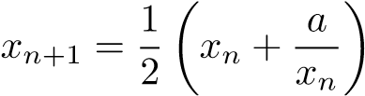
Let‘s get even more lazy
As an example we take Newton’s method to compute positive square roots $x=\sqrt{a}$ for a > 0. The algorithm starts with some guess x₁ > 0 (say a/2) and computes the sequence of improved guesses:
This sequence is infinite, but luckily it converges quickly towards $\sqrt{a}$.
next :: Double -> Double -> Double
next a x_n = (x_n + a/x_n)/2
sequence :: (a -> a) -> a -> [a]
sequence f a = a : (sequence f (f a))
-- (sequence(next 16) 8) ->
[8.0,5.0,4.1,4.001219512195122,4.0000001858445895,4.000000000000004,4.0, …])
within :: Double -> [Double] -> Double
within eps (a:b:rest) =
if abs(a - b) <= eps
then b
else within eps (b:rest)
root :: Double -> Double -> Double
root a eps = within eps (sequence (next a) (a/2))
Because of laziness we can define potentially infinite data structures without producing infinite loops.
This allows for example, to separate the sequencing from validating an approximation. E.g., we could easily swap in a different validation function that compares the ratio (and not the delta) of a and b.
Notes:
The next example demonstrate another common usage of lazy evaluation:
potentially infinite data structures.

Slide 18
Maybe we‘ve got a problem?
The Maybe type is helpful in situations where certain operation may not always return a valid result. It is a simple way to avoid NullPointer errors or similar issues with undefined results. Thus, many languages have adopted this data type under different names. In Java for instance, it is called Optional:
data Maybe a = Nothing | Just a
In FP, it is considered good practise to use total functions – that is functions that have defined return values for all possible input values – where ever possible to avoid runtime errors. (Using total functions greatly increases testability and maintainability of code).
Typical examples for partial (i.e. non-total) functions are division and square roots. We can use Maybe to make them total:
safeDiv :: Double -> Double -> Maybe Double
safeDiv _ 0 = Nothing
safeDiv x y = Just (x / y)
safeRoot :: Double -> Maybe Double
safeRoot x
| x < 0 = Nothing
| otherwise = Just (sqrt x)
Another example is map lookup. When looking up a key in a list of key-value pairs there are two options: If the key is found, the associated value val is returned - but wrapped in a Maybe: Just val. If the key can’t be found, Nothing is returned:
lookup :: String -> [(String,Double)] -> Maybe Double
lookup key [] = Nothing
lookup key ((x,y):xys)
| key == x = Just y
| otherwise = lookup key xys

Slide 19
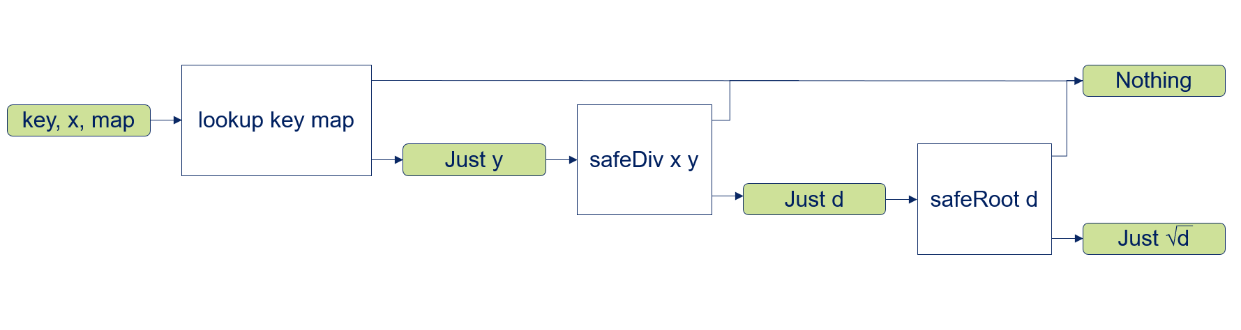
Working with maybes
Now let's consider a situation where we want to combine several of those functions. Say for example we first want to lookup the divisor from a key-value table, then perform a division with it and finally compute the square root of the quotient:
findDivRoot :: Double -> String -> [(String, Double)] -> Maybe Double
findDivRoot x key map =
case lookup key map of
Nothing -> Nothing
Just y -> case safeDiv x y of
Nothing -> Nothing
Just d -> case safeRoot d of
Nothing -> Nothing
Just r -> Just r
-- findDivRoot 27 "v" [("v", 3), ("k", 4)] -> Just 3
In each single step we have to check for Nothing, in that case we directly short circuit to an overall Nothing result value. In the Just case we proceed to the next processing step. This kind of handling is repetitive and buries the actual intention under a lot of boilerplate.
So we are looking for a way to improve the code by abstracting away the chaining of functions that return Maybe values and providing a way to short circuit the Nothing cases.

Slide 20
Programming a semicolon
We need an operator >>= (speak “and then”) that takes the Maybe result of a first function application as first argument, and a function as second argument that will be used in the Just x case and again returns a Maybe result. In case that the input is Nothing the operator will directly return Nothing without any further processing. In case that the input is Just x the operator will apply the argument function fun to x and return its result:
(>>=) :: Maybe a -> (a -> Maybe b) -> Maybe b
Nothing >>= fun = Nothing
(Just x) >>= fun = fun x
We can then rewrite findDivRoot as follows:
findDivRoot :: Double -> String -> [(a, Double)] -> Maybe Double
findDivRoot x key map =
lookup key map >>= λy ->
safeDiv x y >>= λd ->
safeRoot d
findDivRoot :: Double -> String -> [(a, Double)] -> Maybe Double
findDivRoot x key map =
lookup key map >>=
safeDiv x >>=
safeRoot
Side note: In Java the Optional type has a corresponding method: Optional.flatmap
Wow, we just invented Monads! Maybe is a Monadic Container.
In FP this kind of chaining of functions with the >>= operator in the context of a specific data type is quite common. >>= allows sequential execution of expressions (quite similar to a semicolon separated chain of statements in imperative languages).
Thus >>= is sometimes also called a “programmable semicolon”.

Slide 21

Benefits of functional programming
Using FP concepts will help to create better designs.
Designs that:
are more readable (due to their declarative character),
are closer to the problem domain (as intended by domain driven design),
allow equational reasoning (due to immutability & purity),
Highly scalable (immutability makes it easy to run many threads in parallel, see also map-reduce architecture)
will provide a rigid separation of business logic and side effects (e.g. hexagonal architecture, clean architecture),
are flexible for future changes or extensions (composition, higher order functions),
provide better testability (no mocking frameworks required. Supporting BDD, TDD and property based testing),
will need much less debugging (There are no NullPointerExceptions!),
are better to maintain (due to isolated side effects refactoring becomes much easier),
and, last but not least, will be more fun to write.
Notes:
So, this was quite a ride.
If we now look again at the tag cloud, it doesn‘t look so alien as 45 minutes ago.
I think we all now have a better grip on at least some of those terms.
While working through all these concepts we already noted down some benefits of using them.
Now I‘d like to recap these cool things.
My overall take is that FP concepts will help us to create better software designs.
Why?
It allows us to write designs that:

Slide 22
Questions ?

Slide 23
Further readings
Why Functional Programming matters: a classic paper from 1990. I‘ve incorporated several examples from this text into my presentation.
Why Haskell Matters: The extended version of this presentation. Many more code examples.
How FP mattered: similar contents but more abstract.
Funktionale Programmierung geht auch mit/trotz Java: This presentation shows how you can apply functional programming techniques in Java. (It also shows that adding those features on top of an imperative, OO language looks a bit clumsy…)
Learn you a Haskell: Very nice, moderately paced introduction to the language
OO versus FP: A recent blog post on the OO versus FP topic
Why I prefer Functional Programming: Very brief overview highlighting similar ideas as in my presentation

Slide 24
Thank you
Thomas Mahler Senior IT Architect
ista International GmbH
Luxemburgerstraße 1 45131 Essen
Phone: +49 (0) 201 | 459 31 09 Mobile: +49 (0) 172 | 28 567 41 Thomas.mahler@ista.com www.ista.com
Notes:
Contact slide with scroll-over animation.

Slide 25
BACKUP
Notes:
Chapter divider with fade animation.

Slide 26
Returning functions as values (3) 2. Curry & uncurry
-- function taking a tuple of two Integers and computing their product (mul (3,4) -> 12)
mul :: (Integer, Integer) -> Integer
mul (x, y) = x * y
curMul :: Integer -> Integer -> Integer
curMul = curry mul
So what does curry look like? It takes a function of type ((a, b) -> c) as argument
and returns the equivalent curried function of type a -> b -> c:
curry :: ((a, b) -> c) -> a -> b -> c
curry f x y = f (x, y)
Of course the inverse operation also exists:
uncurry :: (a -> b -> c) -> ((a, b) -> c)
uncurry f p = f (fst p) (snd p)
-- (uncurAdd (3,4) -> 7)
uncurAdd :: (Integer, Integer) -> Integer
uncurAdd = uncurry add

Slide 27
Newtons algorithm in Java
Lets have a look at Newton’s method to compute square roots x = √a for a > 0, i.e. to solve x² = a. The algorithm starts with some guess x₁ > 0 and computes the sequence of improved guesses
public static double squareRoot(final double value, final double epsilon) { double temp = 0; double guess = value / 2; while (Math.abs(temp - guess) >= epsilon) { temp = guess; guess = temp - (temp * temp - value) / (2 * temp); } return guess; }

Slide 28
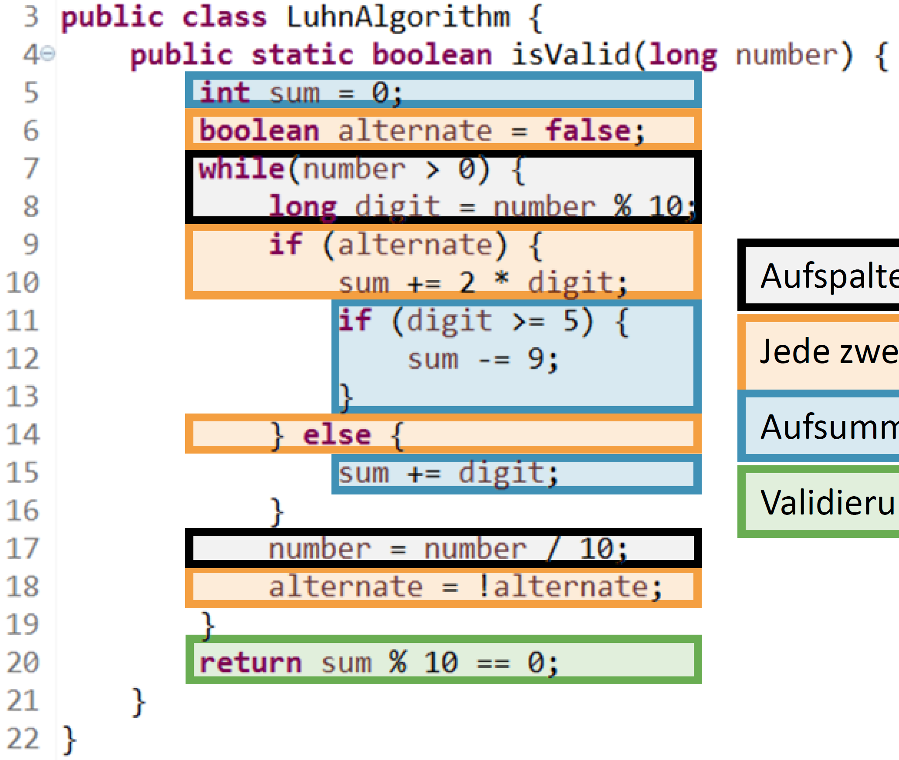
Luhn algorithm: imperative vs. functional
luhnTest :: Natural -> Bool luhnTest = validate . sumUp . doubleEach2nd . splitIntoDigits
splitIntoDigits :: Natural -> [Int] splitIntoDigits = reverse . map digitToInt . show
doubleEach2nd :: [Int] -> [Int] doubleEach2nd = zipWith (*) (cycle [1,2])
sumUp :: [Int] -> Int sumUp = sum . map (uncurry (+) . (`divMod` 10))
validate :: Int -> Bool validate = (0 ==) . (`mod` 10)
split into digits
double each second
sum up
validate
If you read the Funktionale Programmierung geht auch mit/trotz Java slides you‘ll have noticed the Luhn Algorithm example. From the functional implementation we see that FP allows to program in a declarative way, that cleanly keeps different concerns separated.

Slide 29
Notes:
Outro slide (compulsory) with fade animation.

